Slide 1
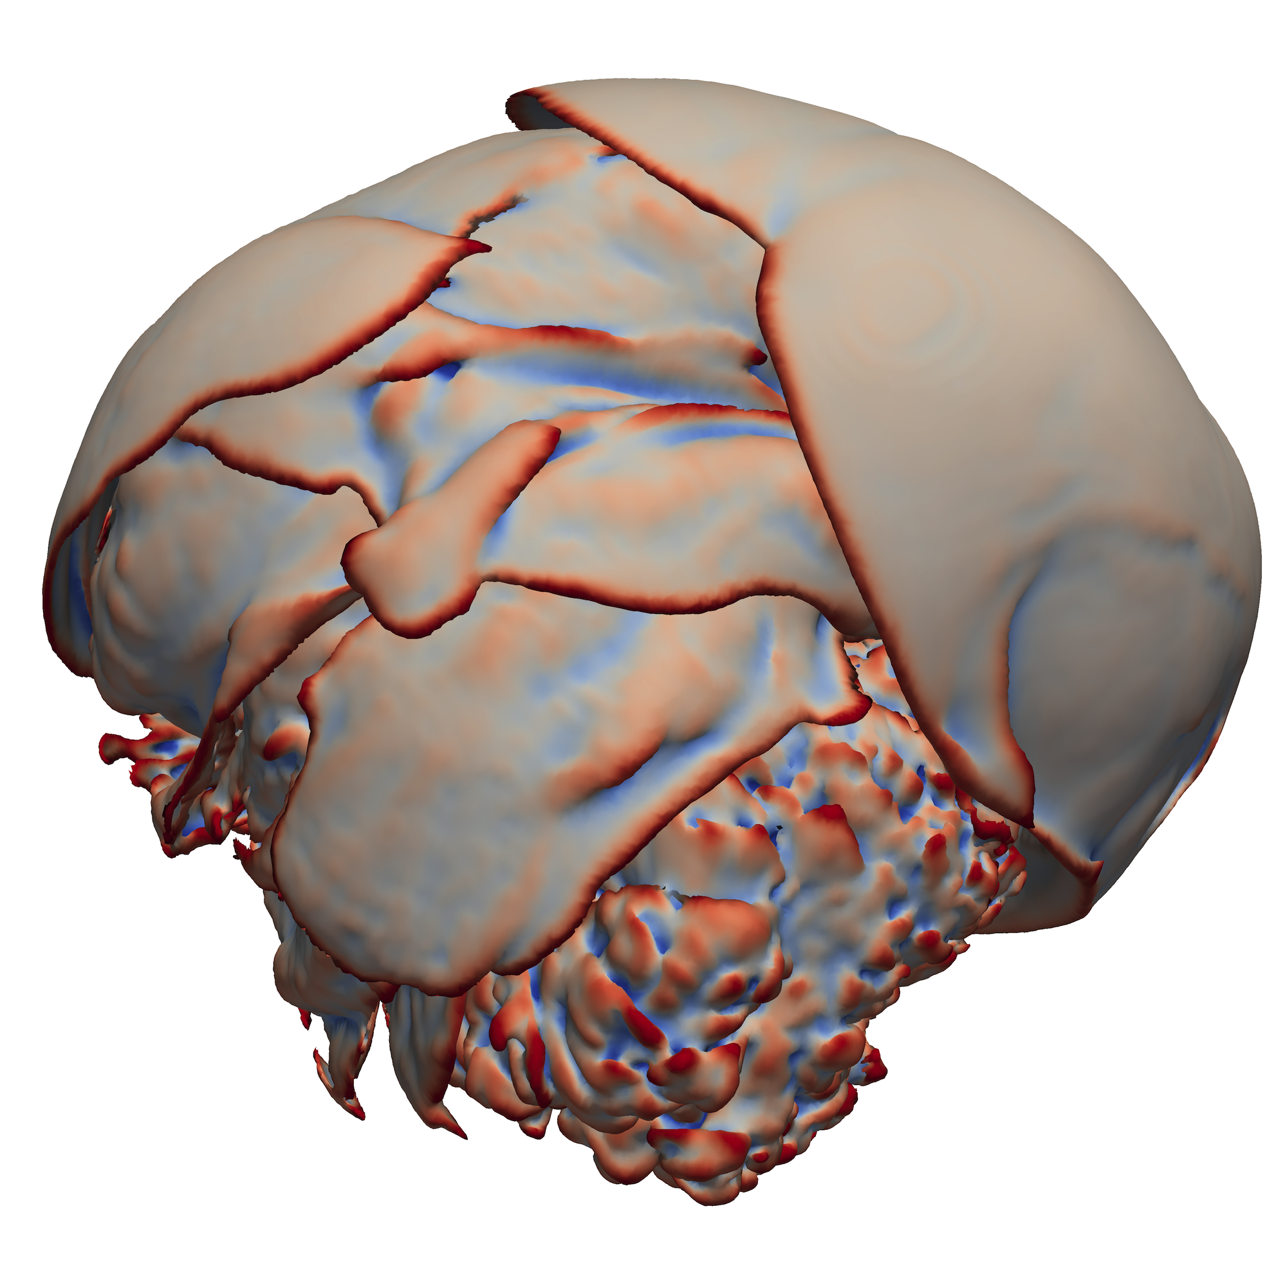
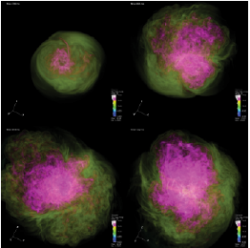
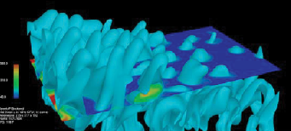
VTK-m
DOECGF
April 29, 2015
Kenneth Moreland Sandia National Laboratories
With contributions from Jeremy Meredith (ORNL), Chris Sewell (LANL), and Robert Maynard (Kitware)

Slide 2

Acknowledgements
This material is based upon work supported by the U.S. Department of Energy, Office of Science, Office of Advanced Scientific Computing Research, under Award Numbers 10-014707, 12-015215, and 14-017566.
X
V
is

Slide 3
Supercomputers!
A clear trend in supercomputing is ever increasing parallelism
Clock increases are long gone
“The Free Lunch Is Over” (Herb Sutter)
 | Jaguar – XT5 | Titan – XK7 | Exascale*
Cores | 224,256 | 299,008 and 18,688 gpu | 1 billion
Concurrency | 224,256 way | 70 – 500 million way | 10 – 100 billion way
Memory | 300 Terabytes | 700 Terabytes | 128 Petabytes
*Source: Scientific Discovery at the Exascale, Ahern, Shoshani, Ma, et al.

Slide 4
“Everybody who learns concurrency thinks they understand it, ends up finding mysterious races they thought weren’t possible, and discovers that they didn’t actually understand it yet after all.” Herb Sutter
Notes:
Dax goals all work together to help reduce the amount of concurrency developers need to handle. Reduce worrying about

Slide 5
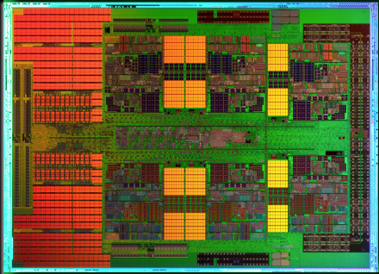
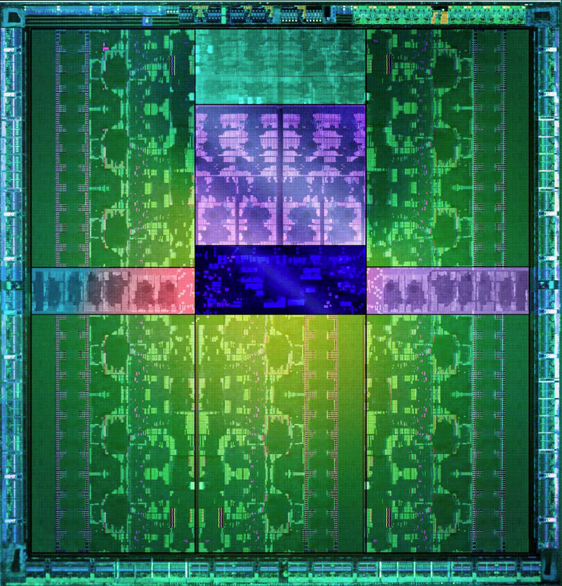
1mm
AMD x86
Full x86 Core
+ Associated Cache
6 cores per die
MPI-Only feasible
1 x86
core
1 Kepler
“core”
NVIDIA GPU
2,880 cores collected in 15 SMX
Shared PC, Cache, Mem Fetches
Reduced control logic
MPI-Only not feasible
Notes:
Why do future architectures pose a problem? After all, we’ve claimed scalable visualization for years.
Becomes somewhat clear when looking at the processor dies.
The x86 core is a complicated device featuring 30 years of components to make your code run faster
An accelerator core, in contrast, is significantly stripped down. In the GPU, really just some arithmetic units
You cannot treat them like a symmetric multiprocessor. They are more like SIMD (but not quite as restrictive).
Running on accelerators is not simply “scaling up” your code
AMD Magny-Cours. Half of 12 core shown.
NVIDIA Kepler GK110. 15 SMX streaming multiprocessor extreme, 192 cores per SMX. 2,880 total cores.

Slide 6
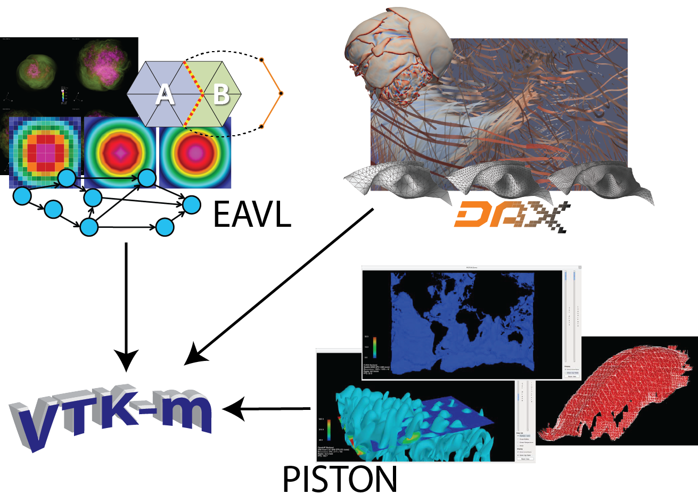

Slide 7
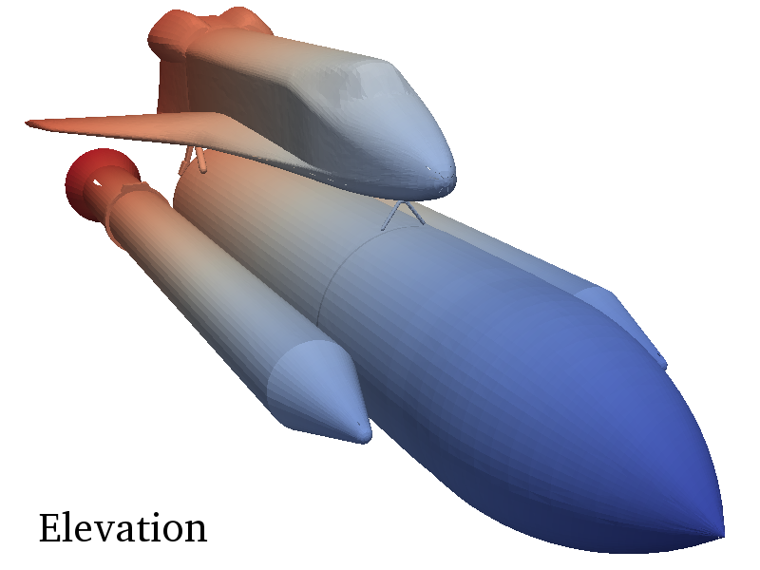
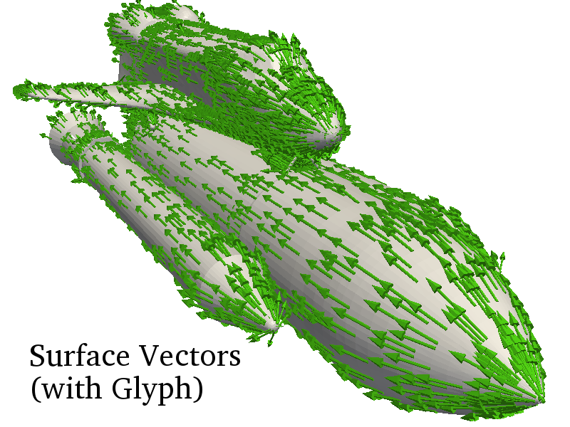
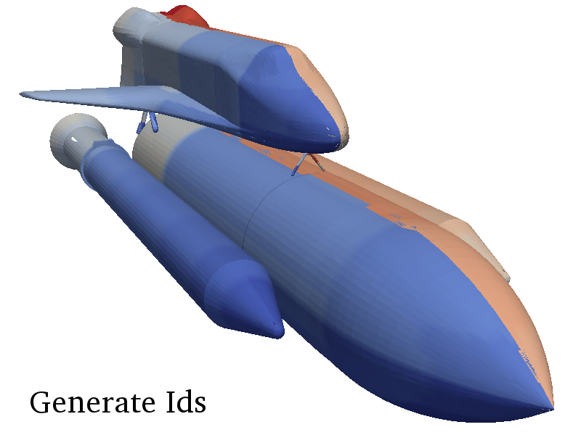
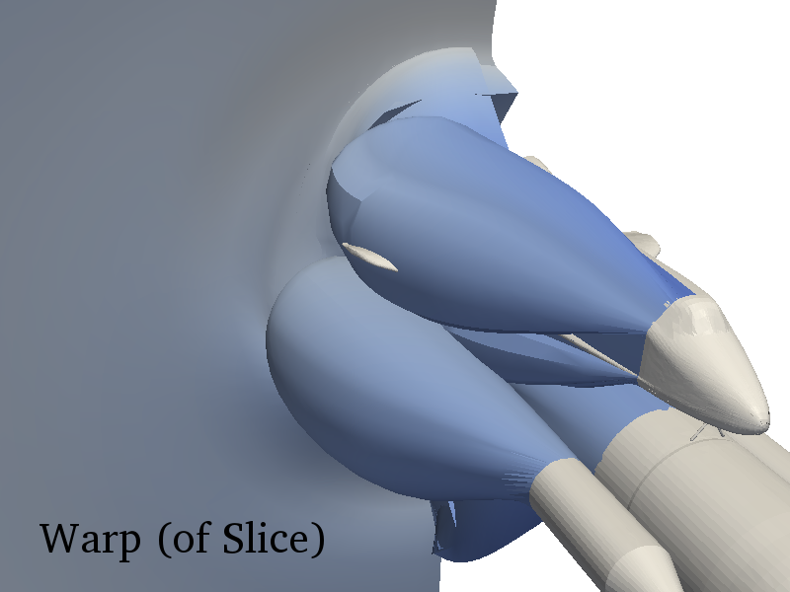
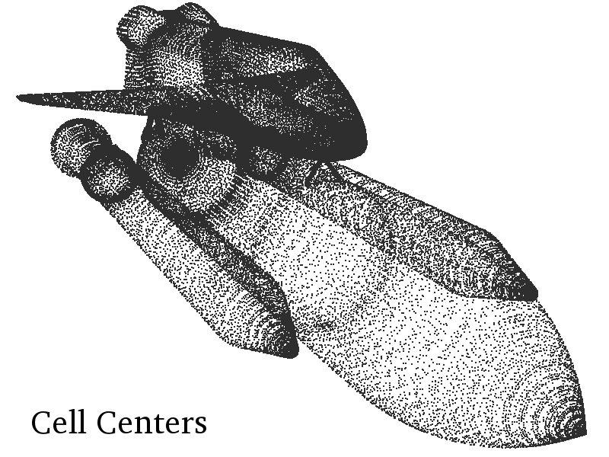
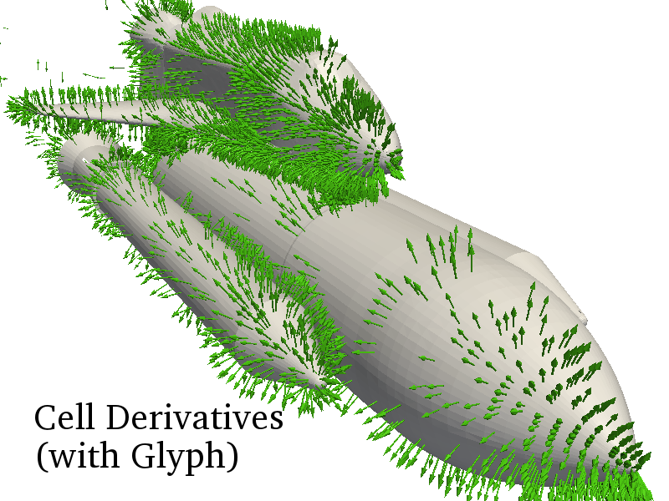
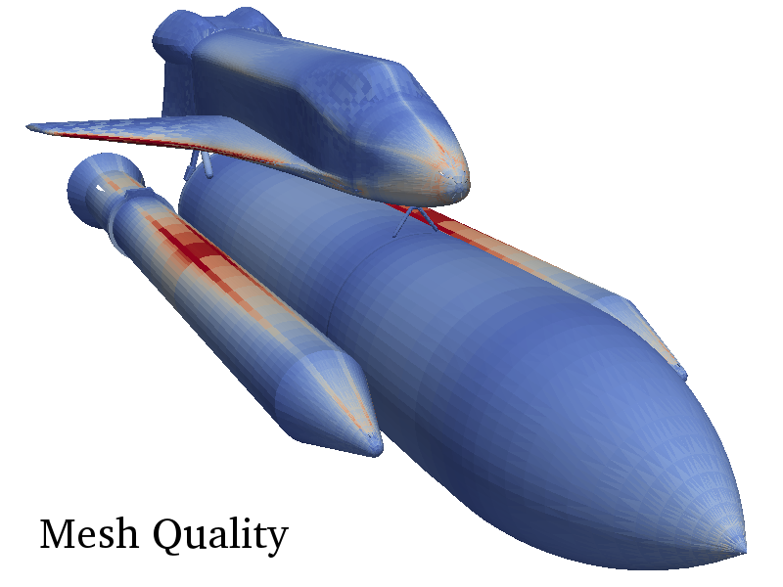
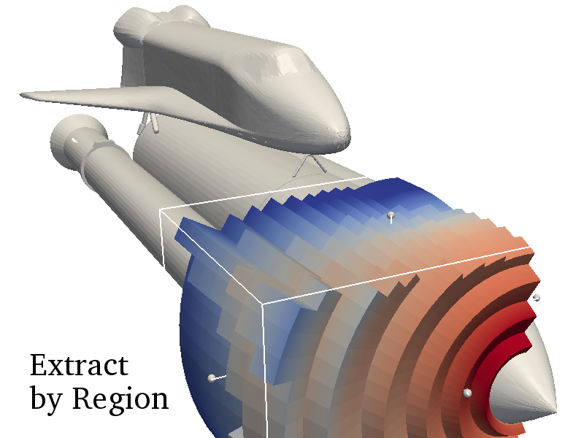
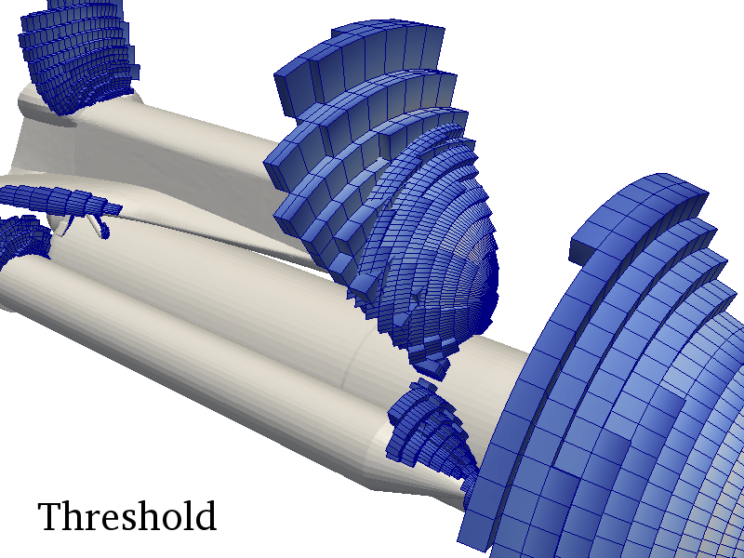
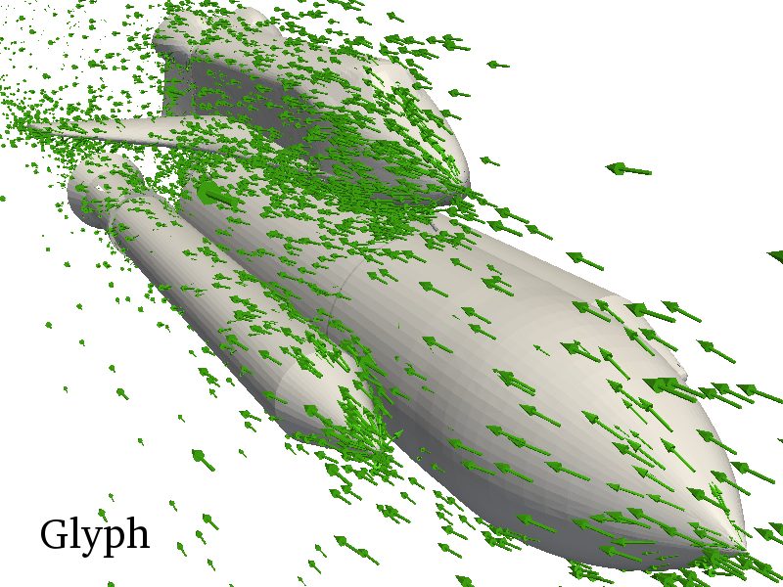
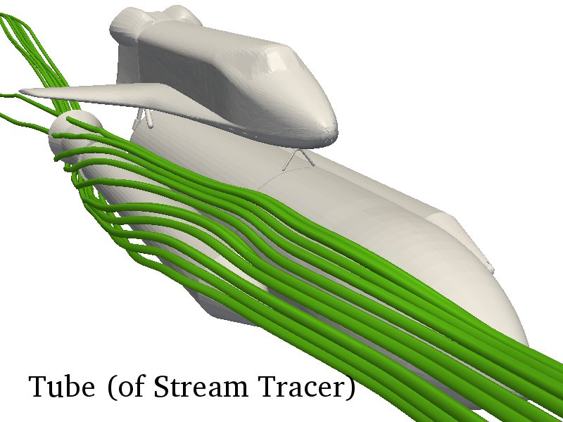
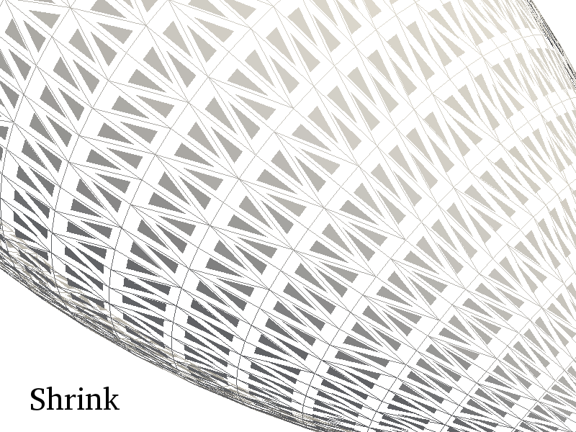
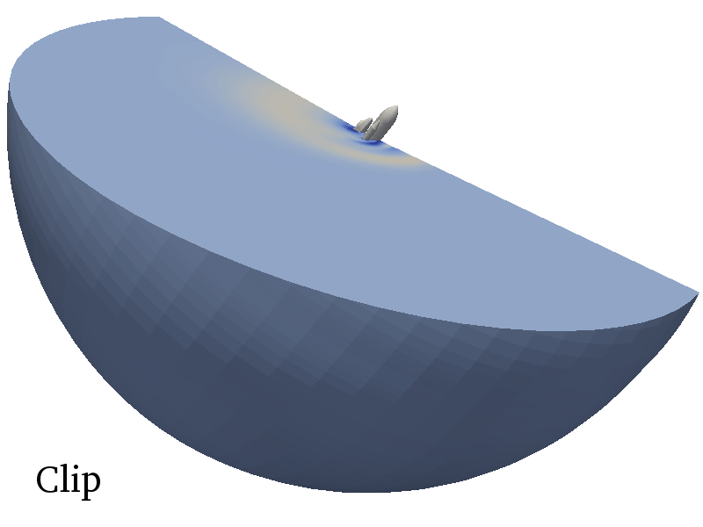
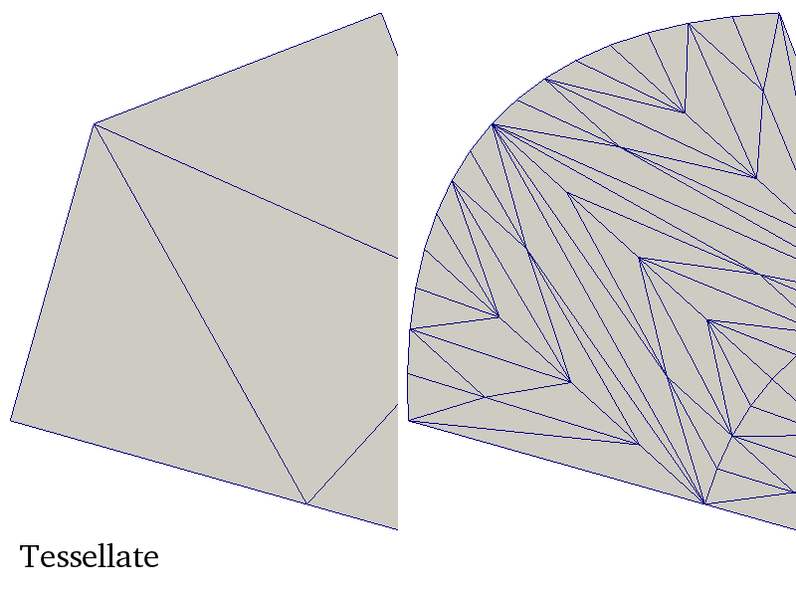
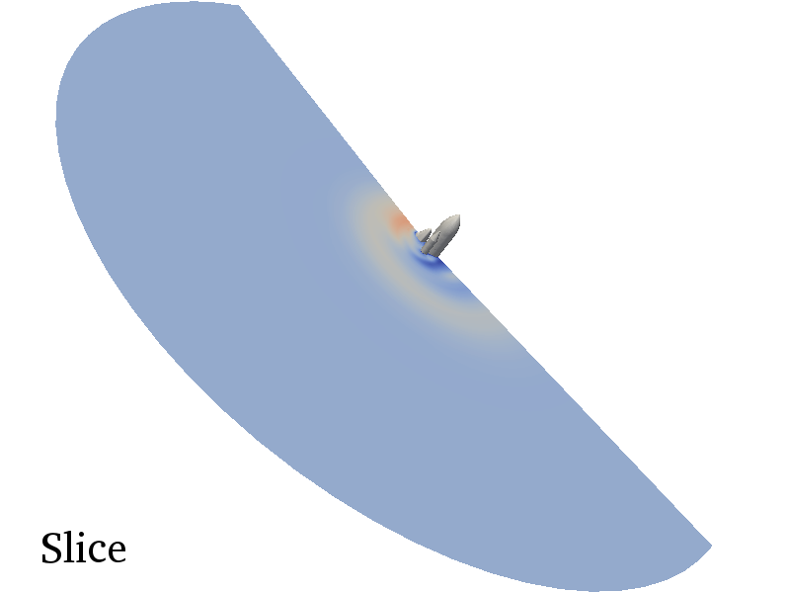
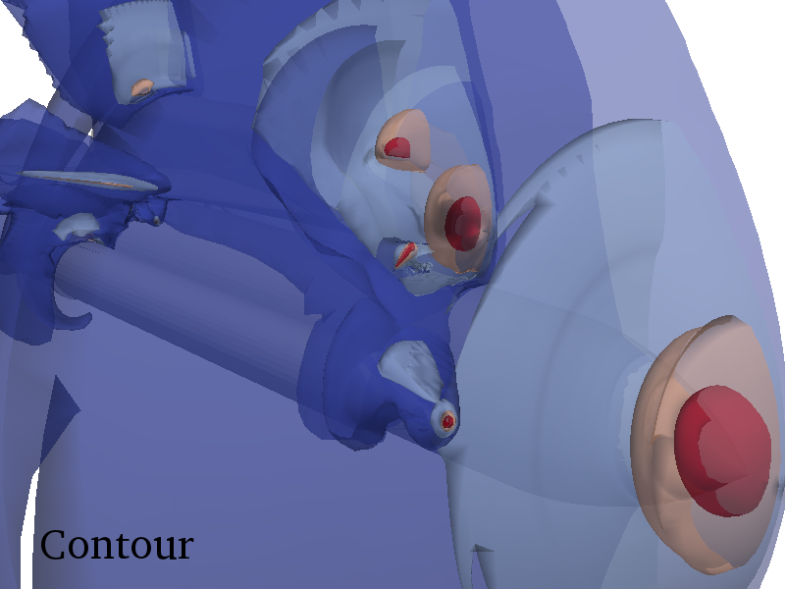
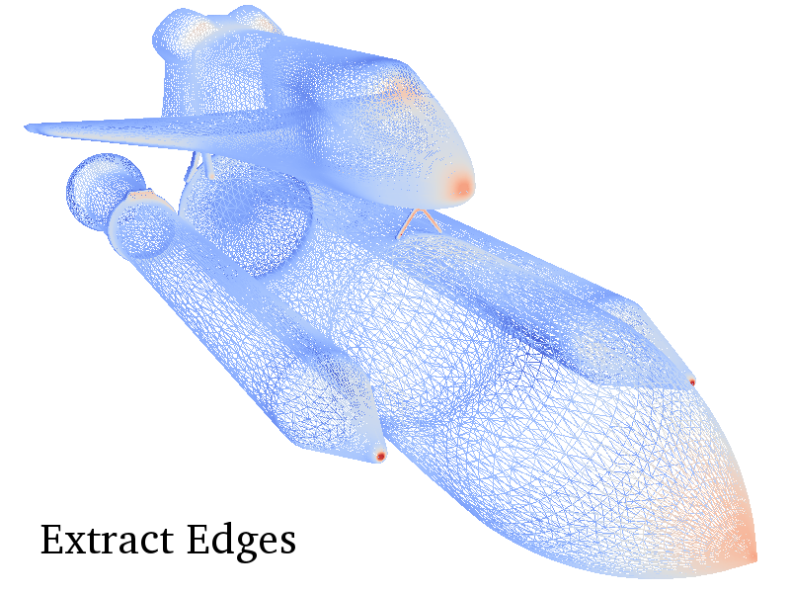
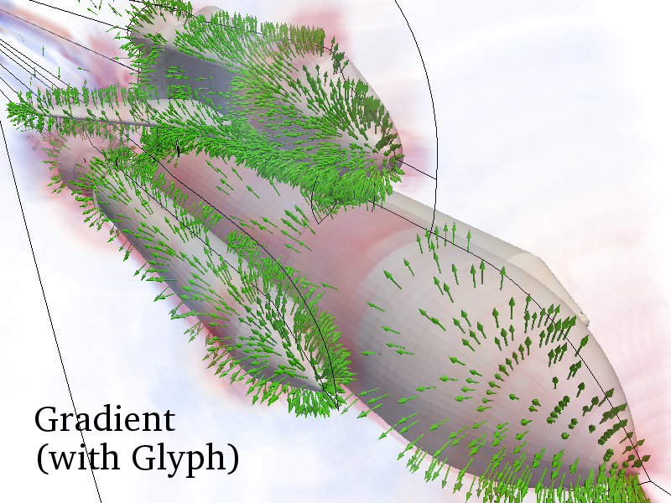
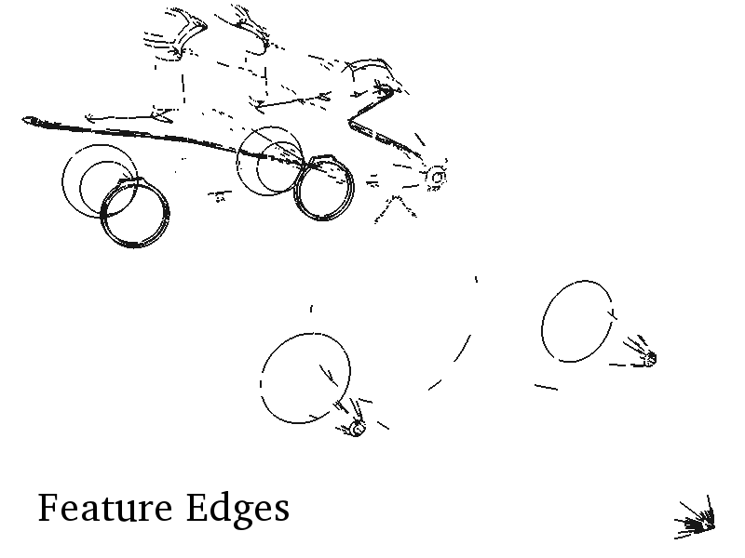
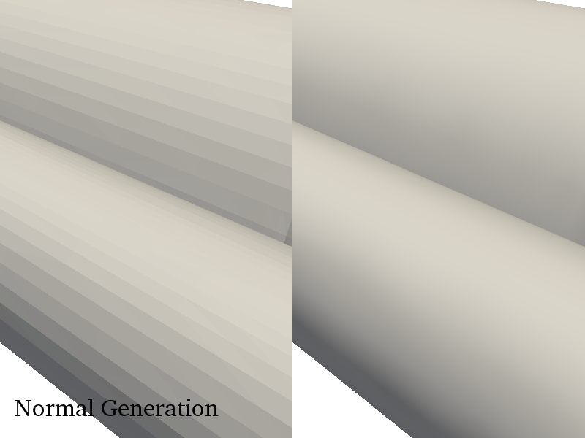
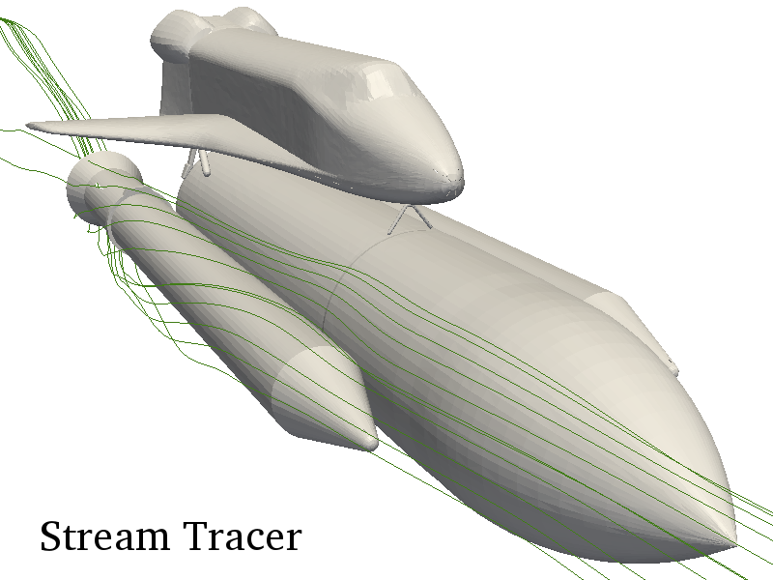
VTK-m Goals
A single place for the visualization community to collaborate, contribute, and leverage massively threaded algorithms
Reduce the challenges of writing highly concurrent algorithms by using data parallel algorithms
Update DOE visualization tools (VTK/ParaView/VisIt) to modern processor technology
Make these algorithms accessible to simulation codes
Notes:
We want to be one happy family to reduce the re-invention of algorithms. As VTK has become a location for researching classic cpu algorithms we want VTK-m to do the same for data parallel algorithm

Slide 8
VTK-m Architecture
Notes:
Discuss the three levels of use
What follows is a brief description of Piston, Dax, and EAVL and how they contribute to the VTK-m architecture

Slide 9
VTK-m Architecture
Notes:
Piston is providing the basic implementation of algorithms within VTK-m and the most basic filtering mechanism (“Here’s my data, run an algorithm on it.”)

Slide 10
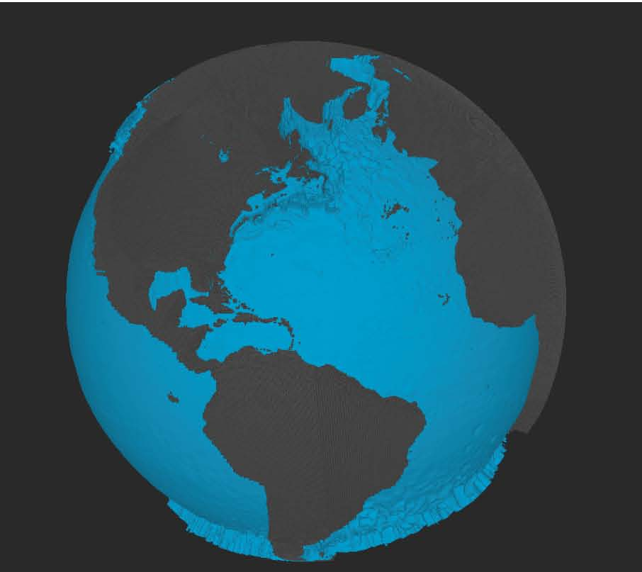
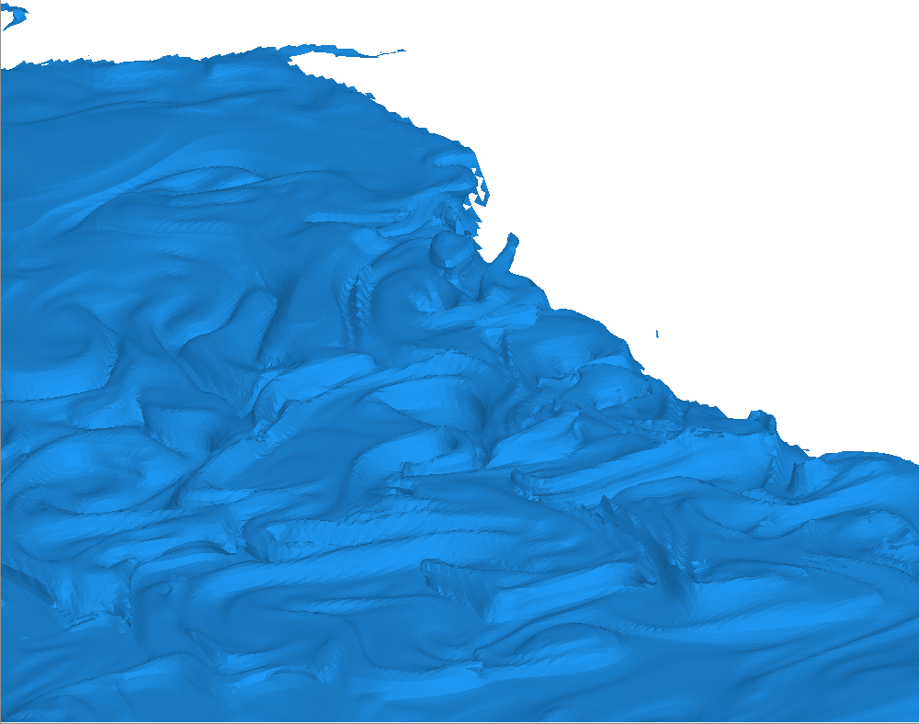
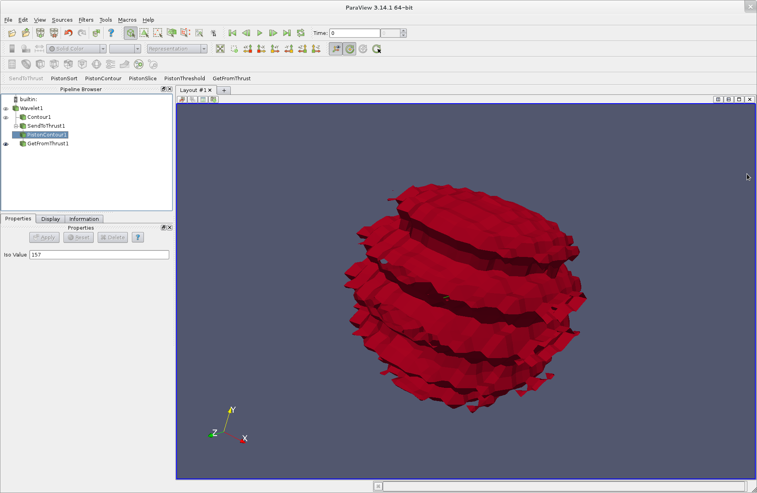
Piston
Focuses on developing data-parallel algorithms that are portable across multi-core and many-core architectures for use by LCF codes of interest
Algorithms are integrated into LCF codes in-situ either directly or though integration with ParaView Catalyst
PISTON isosurface with curvilinear coordinates
Ocean temperature isosurface generated across four GPUs using distributed PISTON
PISTON integration with VTK and ParaView

Slide 11
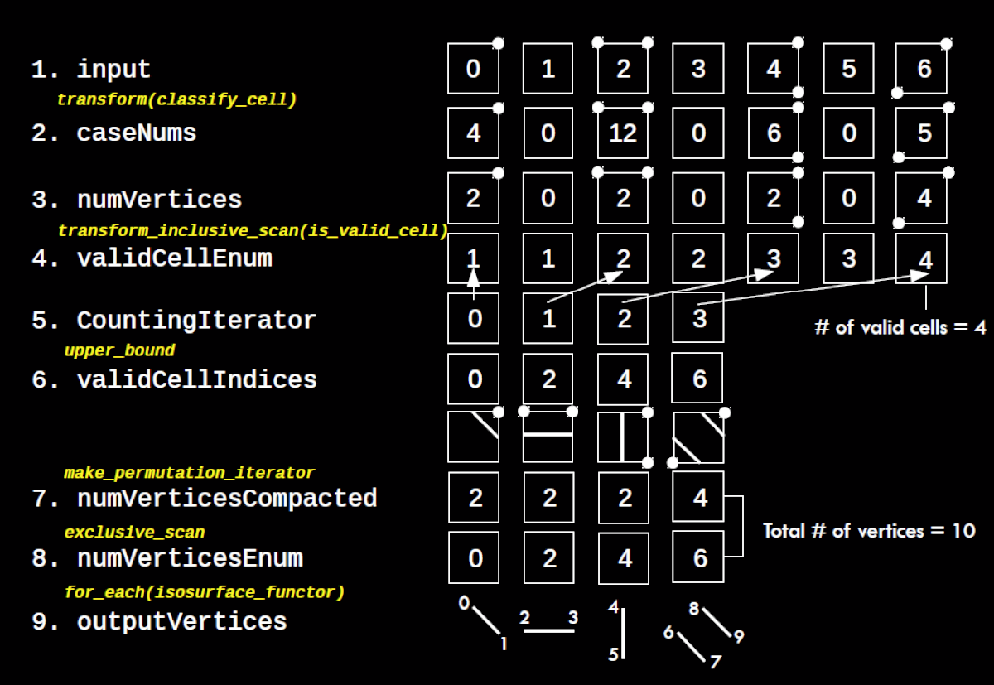
Notes:
The Piston project researched multiple ways to create performance portable visualization algorithms using data parallel primitives. These are being integrated into VTK-m.

Slide 12
VTK-m Architecture
Notes:
Dax is providing the next level of development to simplify the creation of custom visualization algorithms using known patterns

Slide 13
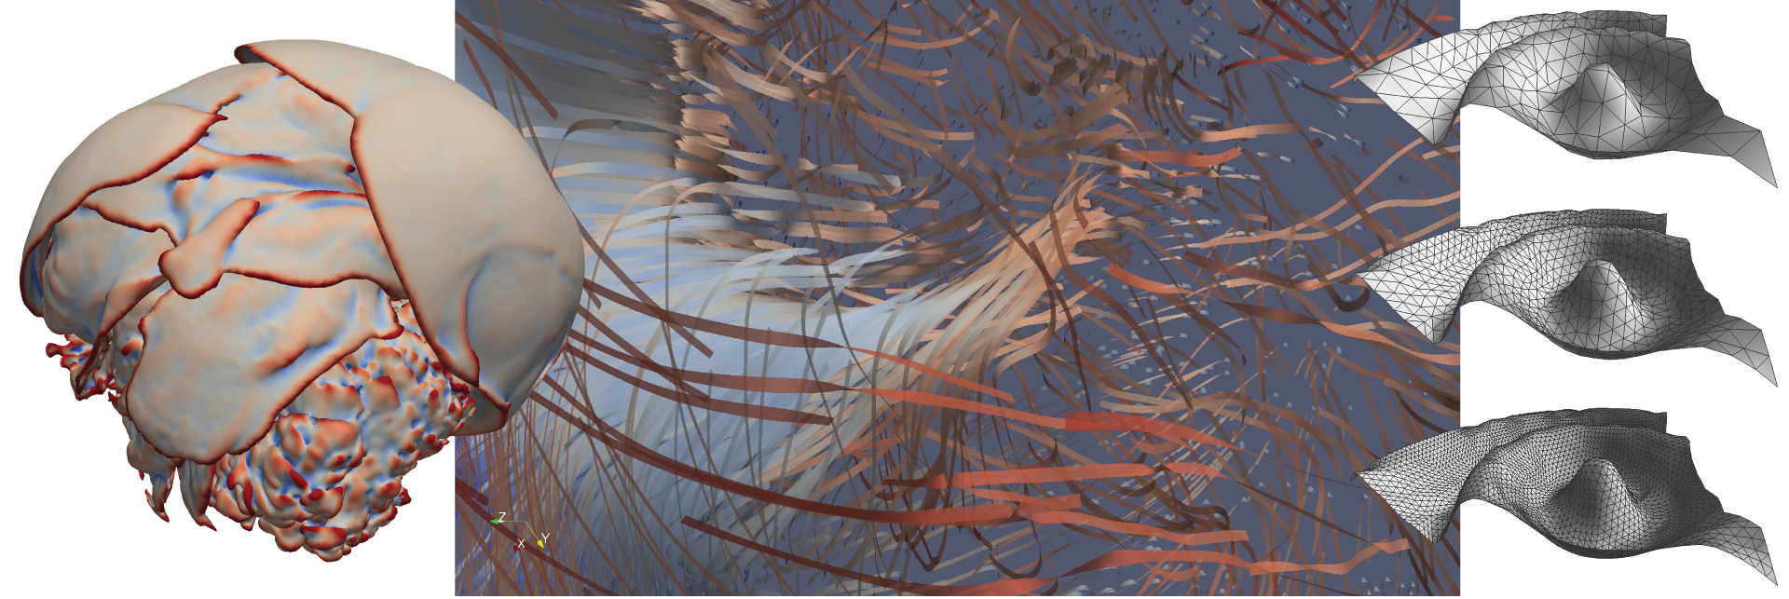
Dax
Create a toolkit that well suited to design of visualization operations with a great number of shared memory threads.
Develop a framework that adapts to emerging processor and compiler technologies.
Design multi-purpose algorithms that can be applied to a variety of visualization operations.

Slide 14
int vtkCellDerivatives::RequestData(...)
{
...[allocate output arrays]...
...[validate inputs]...
for (cellId=0; cellId < numCells; cellId++)
{
...[update progress]...
input->GetCell(cellId, cell);
subId = cell->GetParametricCenter(pcoords);
inScalars->GetTuples(cell->PointIds,
cellScalars);
scalars = cellScalars->GetPointer(0);
cell->Derivatives(
subId, pcoords, scalars, 1, derivs);
outGradients->SetTuple(cellId, derivs);
}
...[cleanup]...
}
struct CellGradient : public WorkletMapCell
{
typedef void ControlSignature(
Topology, Field(Point),
Field(Point), Field(Out));
typedef _4 ExecutionSignature(_1,_2,_3);
template<typename CellTag> DAX_EXEC_EXPORT
Vector3 operator()(...)
{
Vector3 parametricCellCenter =
ParametricCoordinates<CellTag>::Center();
return CellDerivative(parametricCellCenter,
coords,
pointField,
cellTag);
}
};
VTK Code
Dax Code
Notes:
The intention of Dax was to build a development environment similar to VTK where you could drop in an algorithm and the same way as VTK

Slide 15
VTK-m Architecture
Notes:
EAVL is providing the flexible data model that allows algorithms to run across various definitions of data.

Slide 16
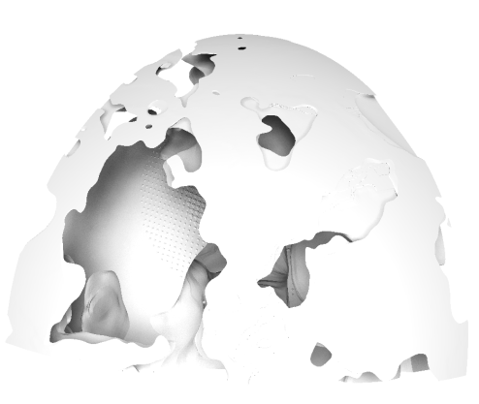
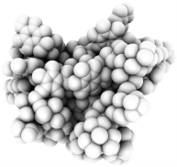
Extreme-scale Analysis and Visualization Library (EAVL)
EAVL enables advanced visualization and analysis for the next generation of scientific simulations, supercomputing systems, and end-user analysis tools.
New Mesh Layouts
Greater Memory Efficiency
More accurately represent simulation data in analysis results
Support novel simulation applications
Support future low-memory systems
Minimize data movement and transformation costs
Parallel Algorithm Framework
In Situ Support
Accelerator-based system support
Pervasive parallelism for multi-core and many-core processors
Direct zero-copy mapping of data from simulation to analysis codes
Heterogeneous processing models
J.S. Meredith, S. Ahern, D. Pugmire, R. Sisneros, "EAVL: The Extreme-scale Analysis and Visualization Library", Eurographics Symposium on Parallel Graphics and Visualization (EGPGV), 2012.
http://ft.ornl.gov/eavl

Slide 17
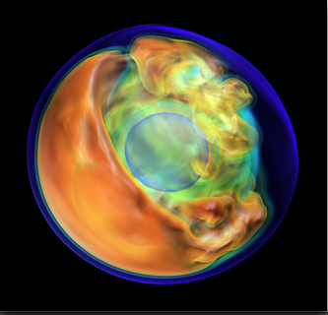
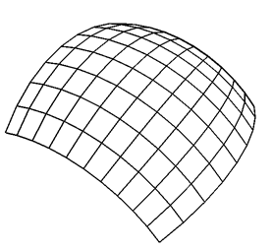
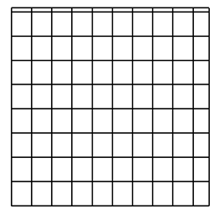


Data Models Supported by EAVL
A
B
Low/high dimensional data
(9D mesh in GenASiS)
Multiple cell groups in one mesh
(E.g. subsets, face sets, flux surfaces)
Multiple simultaneous coordinate systems
(lat/lon + Cartesian xyz)
H
H
C
C
H
H
Non-physical data (graph, sensor, performance data)
Novel and hybrid mesh types
(quadtree grid from MADNESS)
Mixed topology meshes
(atoms + bonds, sidesets)

Slide 18
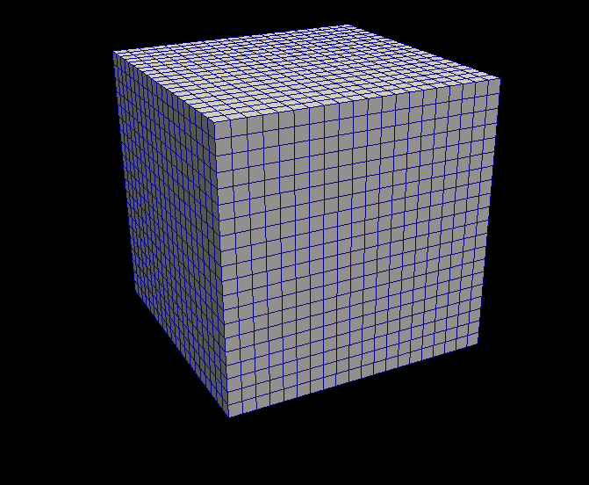
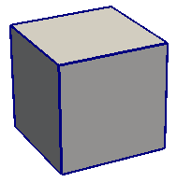
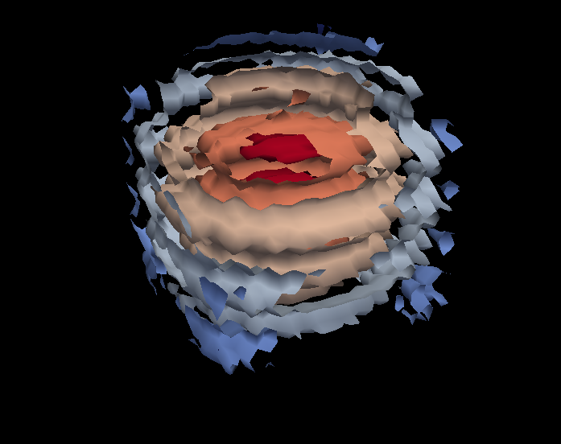
VTK-m Framework
Control Environment
Grid Topology
Array Handle
Invoke
Execution Environment
Cell Operations
Field Operations
Basic Math
Make Cells
Device Adapter
Allocate
Transfer
Schedule
Sort
…
Worklet
vtkm::cont
vtkm::exec
Notes:
These two environments, particularly the execution environment, are meant to work on a variety of architectures.
To manage this portability, we have a unit called a device adapter that sits between these two environments.
The device adapter provides the basic memory management, scheduling, and algorithms needed to run on a parallel device.

Slide 19
Device Adapter Contents
Tag (struct DeviceAdapterFoo { };)
Execution Array Manager
Schedule
Scan
Sort
Other Support algorithms
Stream compact, copy, parallel find, unique
Control Environment
Execution Environment
Transfer
Schedule
worklet
worklet
worklet
functor
worklet
worklet
worklet
worklet
functor
Compute
8
3
5
5
3
6
0
7
4
0
8
11
16
21
24
30
30
37
41
41
8
3
5
5
3
6
0
7
4
0
Compute
0
0
3
3
4
5
5
6
7
8

Slide 20
VTK-m Arbitrary Composition
VTK-m allows clients to access different memory layouts through the Array Handle and Dynamic Array Handle.
Allows for efficient in-situ integration
Allows for reduced data transfer
Control Environment
Execution Environment
Transfer
Control Environment
Execution Environment
Transfer

Slide 21
Functor Mapping Applied to Topologies
functor()
Notes:
Our basic approach to portable and efficient multicore algorithms is essentially that presented by Baker and colleagues.
Break the algorithm into sections that can be run on single (or small) sections of data and encapsulate that in a C++ functor object.
Using generic programming, provide a mapping function to schedule the functor on many threads to concurrently process a vector.
Dual benefits:
Simplifies algorithm design by placing the bulk of the work in a serial functor.
One porting of the map function to multiple parallel systems can be applied to any number of functor algorithms. Also works well in lightweight thread environment.
However, we find this basic model a bit too simplistic.
We are most interested in mapping operations to connected topologies, which means that the inputs and outputs of the operations are dependent on these connections.
For example, the computation of an operation may depend on a collection of data around a small neighborhood.

Slide 22
Functor Mapping Applied to Topologies
functor()
Notes:
We also have to consider that the values created by a functor may not be independent
For example, they might combine together to form a connected topology
If necessary, we might need to rebuild these connections

Slide 23
2 x Intel Xeon CPU E5-2620 v3 @ 2.40GHz + NVIDIA Tesla K40c

Slide 24
2 x Intel Xeon CPU E5-2620 v3 @ 2.40GHz + NVIDIA Tesla K40c
Data: 432^3

Slide 25
What We Have So Far
Features
Core Types
Statically Typed Arrays
Dynamically Typed Arrays
Device Interface (Serial, CUDA)
Basic Worklet and Dispatcher
Compiles with
gcc (4.8+), clang, msvc (2010+), icc, pgi, nvcc
User Guide work in progress
Ready for larger collaboration

Slide 26
Questions?
m.vtk.org

